Slide 1



Fraud Detection for Transaction
Kausik Chattapadhyay
Bellevue University
DSC680: Applied Data Science
Prof. Amirfarrokh Iranitalab

Slide 2

Business Problem
The Fraud Company targets better fraud detection in the Brazilian/South America market.
Revenue-sharing heavily hinges on accurate fraud detection, posing significant financial risks.
A machine learning model is developed to predict transaction legitimacy, mitigating financial risks linked to fraud.

Slide 3



Background/History
The Fraud Company employs a performance-based fee model for detecting mobile device financial fraud.
Its aggressive strategy includes earning revenue from both successful fraud detections and misclassified transactions.
The company's financial success relies on the accuracy of its anti-fraud models to balance revenue generation and risk coverage.

Slide 4
Business Assumption
Fraud prevention aims to detect and stop fraudulent transactions, safeguarding financial institutions and clients from financial damage and reputational harm.
With fraud occurring through both virtual and physical means, investments in security have seen a rise to combat these threats.
Febraban's 2020 Banking Technology Survey highlights that fraud losses can amount to R$ 1 billion, half of what institutions invest annually in information security systems.

Slide 5
Business Questions
What is the model's Precision and Accuracy?
How Reliable is the model in classifying transactions as legitimate or fraudulent?
What is the Expected Billing by the Company if we classify 100% of transactions with the model?
What is the Loss Expected by the Company in case of model failure?
What is the Profit Expected by the Fraud Company when using the model?

Slide 6
Solution Strategy
Development of a data science project with a machine learning model to predict fraudulent transactions.
Steps include data collection, descriptive statistics, feature engineering, data filtering, exploratory analysis, and data preparation.
Further steps involve feature selection, machine learning modeling, hyperparameter tuning, conclusions, and model deployment via Flask API.
The process includes hypothesis testing, algorithm selection, and fine-tuning for optimal model performance.
Ultimately, the project aims to provide actionable insights and deployable solutions for fraud detection in transactions.

Slide 7
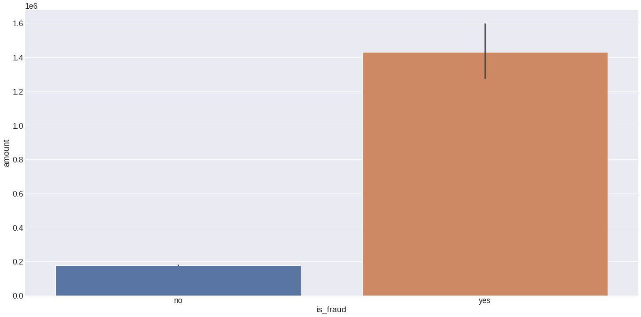
Top Data Insights
All the fraud amount is greater than 10.000.
TRUE: The values are greater than 10.000. But it is important to note that the no-fraud values are greater than 100.000 also.

Slide 8
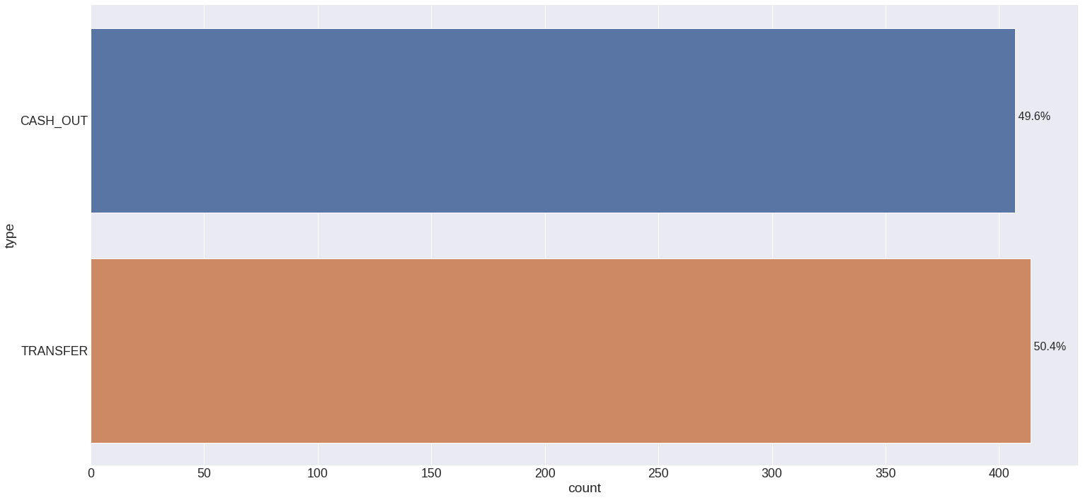
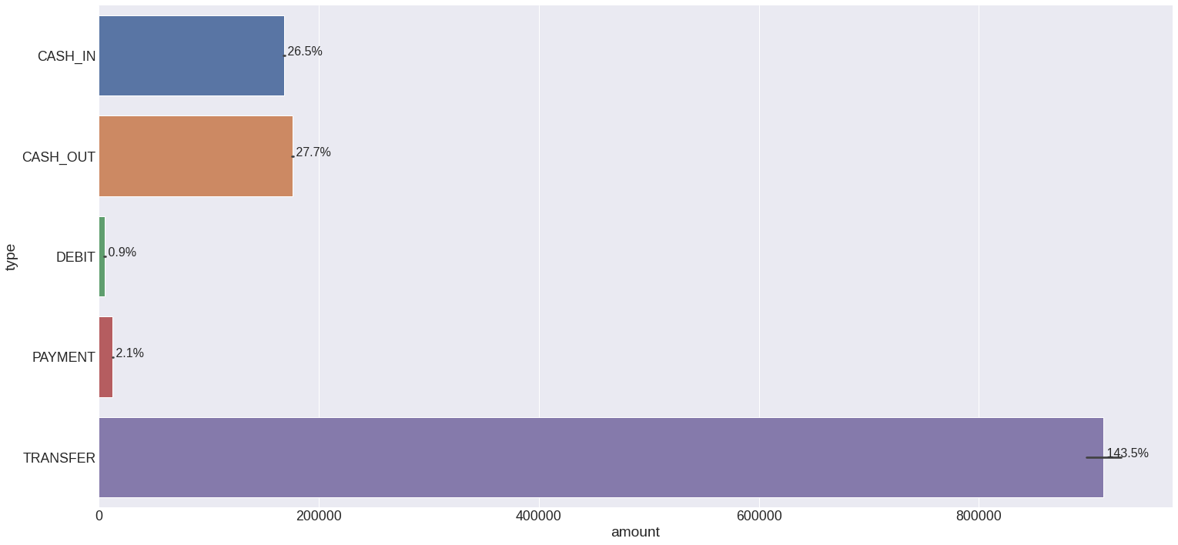
Top Data Insights
60% of Fraud transactions occur using the cash-out-type method.
Values greater than 100.000 occurs using the transfer-type method.

Slide 9
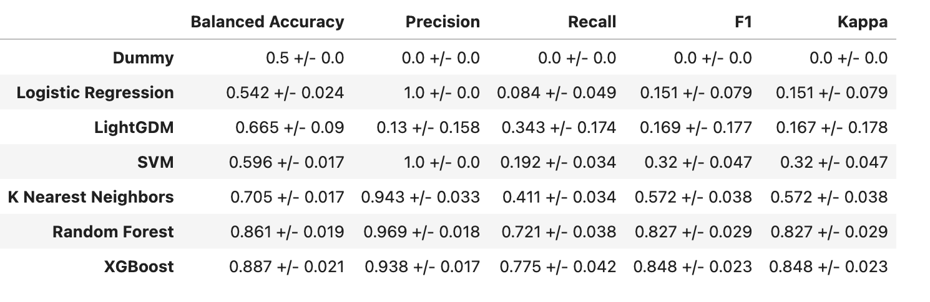
Model cross-validation comparison

Slide 10
Business Results
The company earns 25% of transaction values correctly detected as fraud, potentially totaling R$ 60,613,782.88 in revenue.
Additionally, the company receives 5% of transaction values for false positives (fraud detected, but transaction legitimate), totaling R$ 183,866.98.
On the flip side, the company refunds 100% of transaction values for false negatives (legitimate transactions misclassified as fraud), totaling R$ 3,546,075.42.
The model's performance metrics include a balanced accuracy of 91.5%, precision of 94.4%, and the ability to detect approximately 76.3% of frauds, with an observed detection rate of 0.829 for unseen data.

Slide 11
Conclusion
Successful data analysis despite extreme data imbalance, resulting in promising revenue projections for the company.
Ethical considerations include addressing data privacy, bias mitigation in model predictions, and safeguarding against false identifications.
Challenges involve imbalanced data and ensuring model interpretability, especially in financial decision-making contexts.
Lessons learned highlight the potential for accurate modeling even with highly imbalanced classes.
Next steps include hypothesis testing, implementing sampling techniques for improved model performance, and deploying the API on the Heroku platform.

Slide 12

References
https://www.kaggle.com/datasets/ealaxi/paysim1

